Slide 1

IFET COLLEGE OF ENGINEERING
(An Autonomous Institution)
Department of Computer Science and Engineering
Survival prediction of Cardio-Vascular Diseases (CVD) using machine learning techniques
PRESENTED BY,
RAMKUMAR R
Reg. No: 421118104070/CSE/IV
GUIDED BY
Mr. RAMKUMAR M.O
Associate Professor-CSE,

Slide 2
Synopsis:
Abstract
Introduction
Literature Survey
System Architecture
Existing System
Proposed System
Module Design
Advantages
Disadvantages
Conclusion

Slide 3
Abstract:
The goal of this research is to develop a reliable decision-support system for the survival prediction of heart failure patients by utilizing their clinical records and laboratory test results.
Medicine and healthcare are some of the most crucial parts of economy and human life.
The algorithms are followed Balanced Random Forest(BRF), K-Nearest Neighbors(KNN) algorithm, Supervised Machine Learning(SVM) algorithm, XGBoost algorithm.

Slide 4
Introduction:
Heart failure (HF) is condition that occurs when the heart is unable to pump enough to the body, and it usually caused by chronic conditions such as coronary heart disease, high blood temperature, or other heart conditions or diseases.
The number of patients with HF worldwide has increased drastically, moving in 1990 to staggering 64.3 million in 2017.
Chi-square test, which is a popular method used in statistics to test the independence of the two events, is utilized in this study to identify the features which are highly dependent on the response variable.
Recursive Feature Elimination (RFE), which is a popular wrapper-based approach, was utilized to identify a subset of features that can optimize the prediction performance for the proposed balanced RF classifier.

Slide 5
Literature Survey:
SNO | TITLE | YEAR | Author
1 | Survival prediction of heart failure patients using machine learning techniques | 2021 | Asif Newaz * , Nadim Ahmed, Farhan Shahriyar Haq
2 | Prediction of Cardiac Disease using Supervised Machine Learning Algorithms | 2020 | R.Jane Preetha Princy Karunya Institute of Technology and Sciences, Coimbatore
3 | Heart Disease Prediction Using Machine Learning Algorithms | 2020 | Archana Singh Computer Science and Engineering Madan Mohan Malaviya University of Technology Gorakhapur, 273010

Slide 6
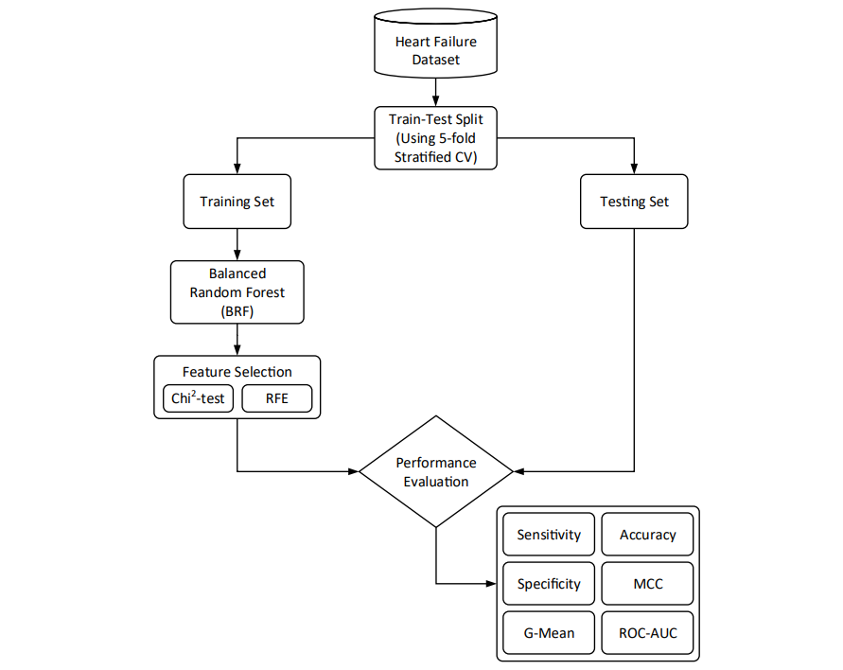
System Architecture:

Slide 7
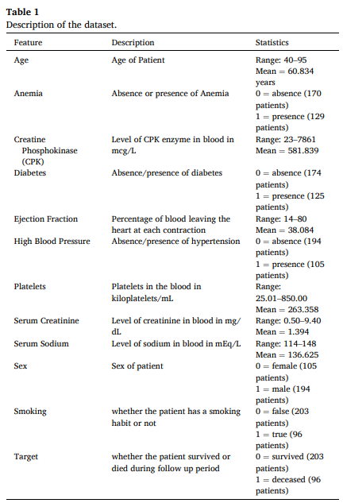
Dataset Description:

Slide 8
Existing System:
Balanced random forest classifier (BRF)
Data-level modification or sampling is a standard approach to deal with the imbalanced classification problem, Standard RF classifier fails to tackle the class imbalance issue, getting biased towards the majority class.
In order to prevent that, the sampling strategy is incorporated in the model construction stage of the RF classifier.
It requires much computational power as well as resources as it builds numerous trees to combine their outputs. It also requires much time for training as it combines a lot of decision trees to determine the class. Due to the ensemble of decision trees, it also suffers interpretability and fails to determine the significance of each variable.

Slide 9
Disadvantages:
It requires much computational power as well as resources as it builds numerous trees to combine their outputs.
It also requires much time for training as it combines a lot of decision trees to determine the class.
Due to the ensemble of decision trees, it also suffers interpretability and fails to determine the significance of each variable.

Slide 10
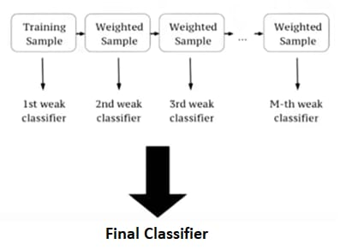
Proposed System (XGBOOST):
XGBoost is an implementation of Gradient Boosted decision trees. It has recently been dominating in applied machine learning.
In this algorithm, decision trees are created in sequential form. Weights play an important role in XGBoost. Weights are assigned to all the independent variables which are then fed into the decision tree which predicts results. Weight of variables predicted wrong by the tree is increased and these the variables are then fed to the second decision tree.
These individual classifiers/predictors then ensemble to give a strong and more precise model. It can work on regression, classification, ranking, and user-defined prediction problems.

Slide 11
Advantages:
It is Highly Flexible.
It uses the power of parallel processing.
It is faster than Gradient Boosting.
It supports regularization.
It is designed to handle missing data with its in-build features.
The user can run a cross-validation after each iteration.

Slide 12
Module Design:
Module Name: Classification and deployment of efficient machine learning model
Description:
Weights are assigned to all the independent variables which are then fed into the decision tree which predicts results.
Weight of variables predicted wrong by the tree is increased and these variables are then fed to the second decision tree.
These individual classifiers/predictors then ensemble to give a strong and more precise model.
It can work on regression, classification, ranking, and user-defined prediction problems.
Dataset
Xgboost Classification
Final Output Machine Learning Model

Slide 13
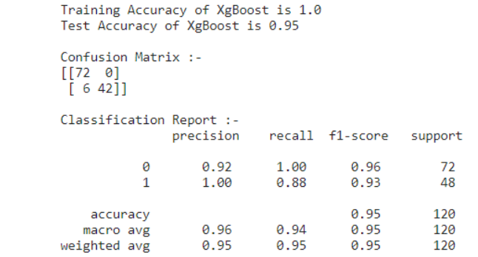
Module Design:
Module Name: Xgboost Classification
Output:

Slide 14
Conclusion:
We have developed a model to build a reliable decision support system for survival prediction of heart failure patients by using XGBoost algorithm.
The performance achieved on the publicly available HF dataset as well as the versatility of the proposed approach indicates that it has the potential to be a reliable tool that can be utilized in clinical practice to assist clinicians and practitioners in decision-making.

Slide 15
Thank you!

